Slide 1

RVR&JC COLLEGE OF ENGINEERIng Mini-project ONLINE-ORGANIC-VEG MART

Slide 2
PROBLEM STATEMENT
Organic veg mart is a project which aims to provide fresh and organic vegies for it’s customers. Making this store available in online helps customers to buy their items straight away from their place. Here in this project the key roles are played by Admin and User. The whole process of this Online Organic Veg Mart is mentioned below.

Slide 3
SYSTEM REQUIREMENTS
Software Requirements:
Operating System: Windows 7 or more
Coding Language: HTML5,CSS,BOOTSTRAP & PHP
Database: MYSQL
Hardware Requirements:
Personal computer with keyboard and mouse maintained with uninterrupted power supply.
Processor: I3 or above
RAM: 1GB or more

Slide 4
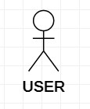
SIGNIFICANCE OF USECASE IN DESIGNING
Use-case diagrams graphically represent system behaviour. These diagrams present a high level view of how the system is used as viewed from an outsider’s perspective.
Use-case diagrams can be used during analysis to capture the system requirements and to understand how the system should work. During the design phase, you can use use-case diagrams to specify the behaviour of the system as implemented.
Actors and Use case’s plays key role in use case diagrams. An actor is a stereotype of a class and is depicted as a “stickman” on a use-case diagram and Use case can be described as a specific way of using the system from a user’s perspective.
ACTOR USE-CASE

Slide 5
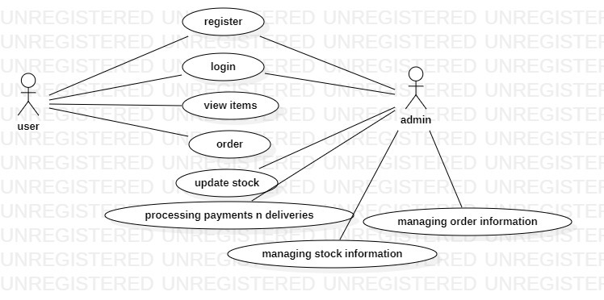
USECASE DIAGRAM:ORGO-V-MART

Slide 6
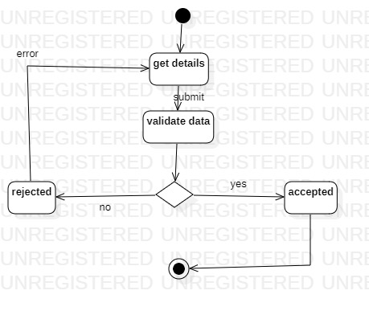
ACTIVITY DIAGRAM:SIGNUP
The purpose of Activity diagram is to provide a view of flows and what is going on inside a use case or among several classes.
Activity diagrams are very similar to a flowchart because you can model a workflow from activity to activity.

Slide 7
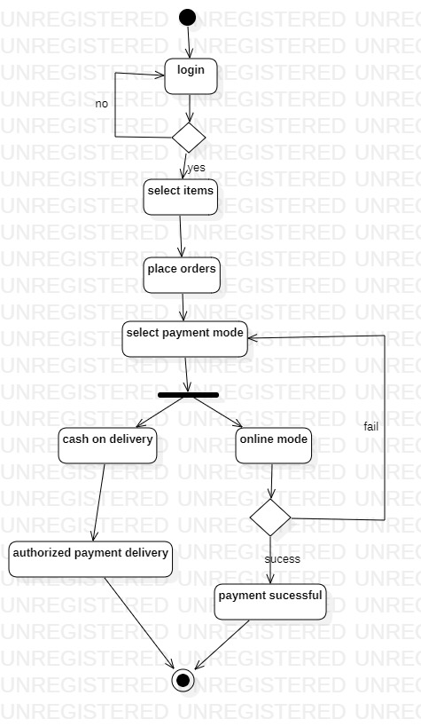
Activity diagram for Ordering items

Slide 8
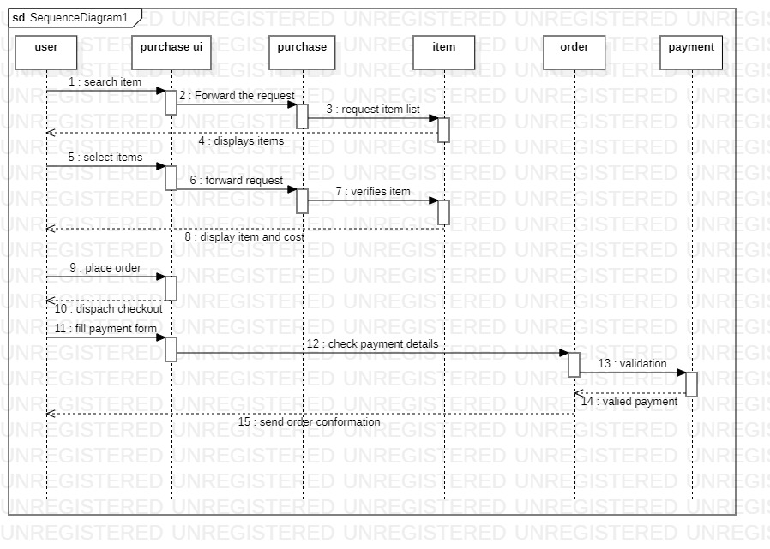
SEQUANCE DIAGRAM
A sequence diagram is a graphical view of a scenario that shows object interaction in a time based sequence-- what happens first, what happens next. A sequence diagram should not draw for alternative flow.
SEQUANCE DIAGRAM FOR
ORDERING ITEMS

Slide 9
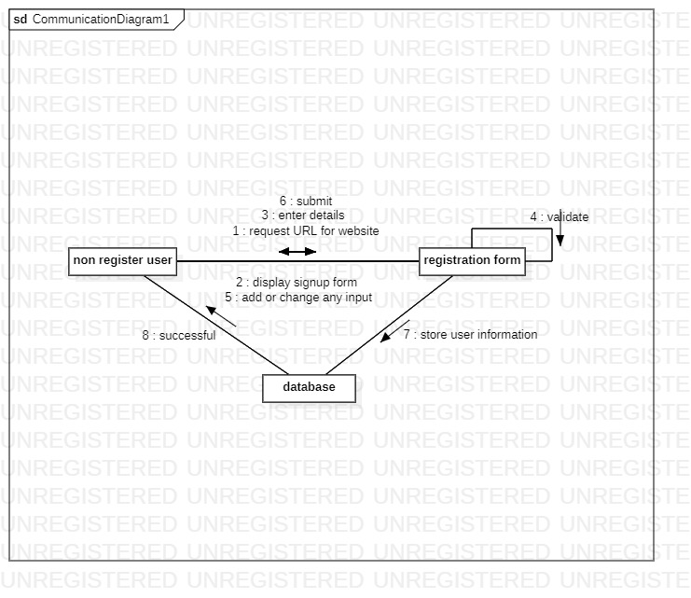
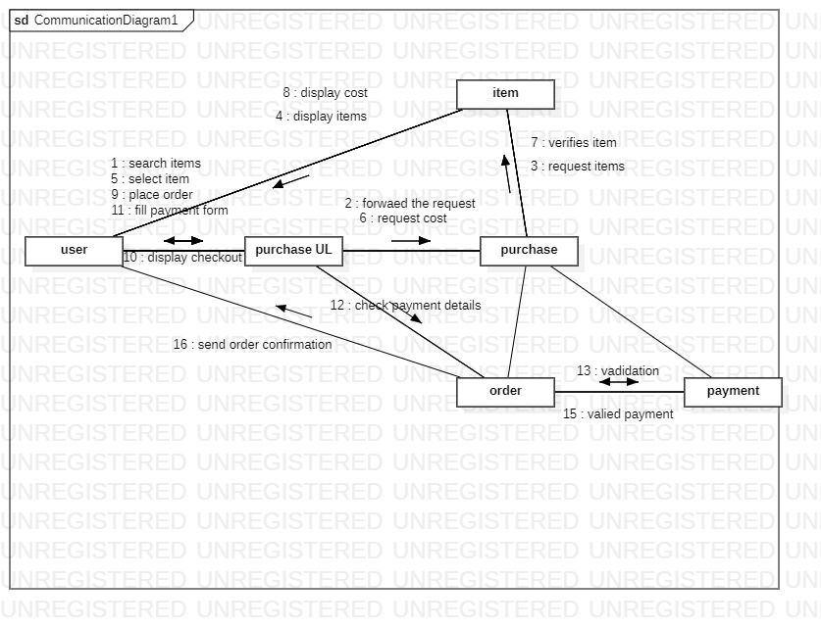
COLLABORATION DIAGRAMS:
FOR SIGNUP/REGISTRATION
FOR ORDERING ITEMS

Slide 10
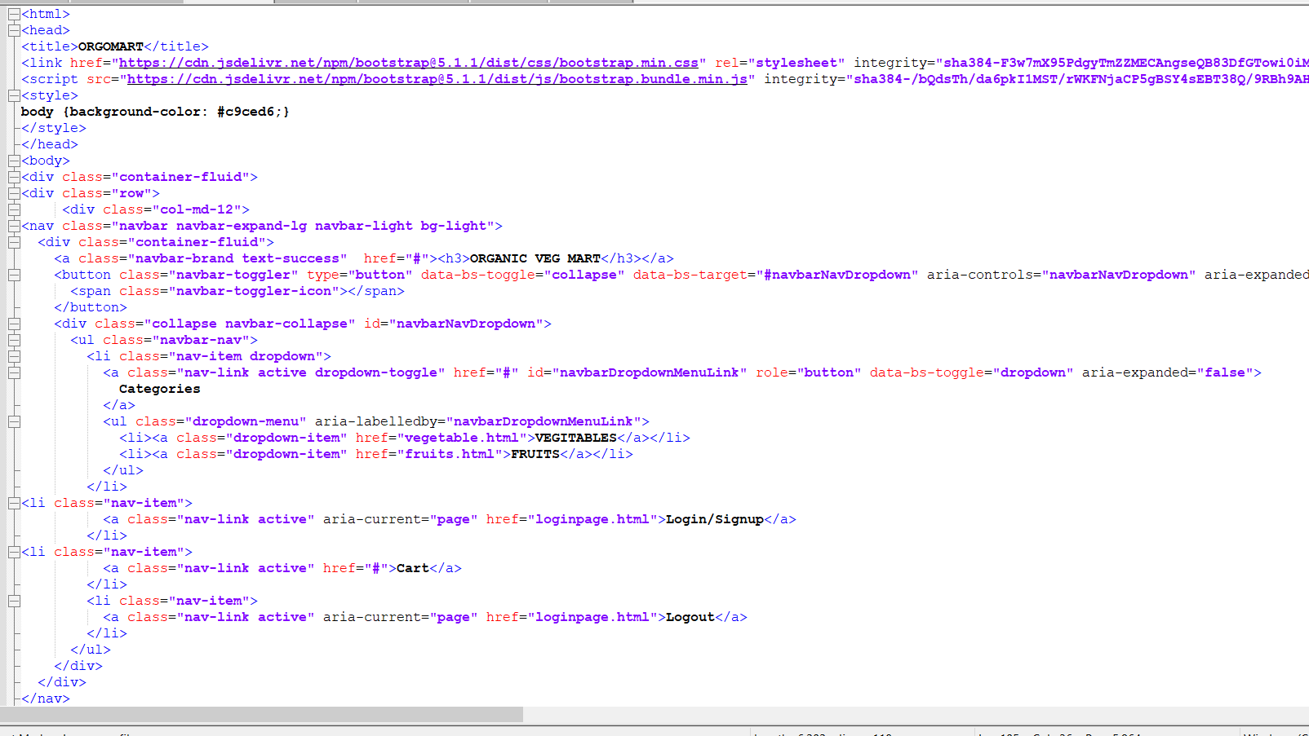
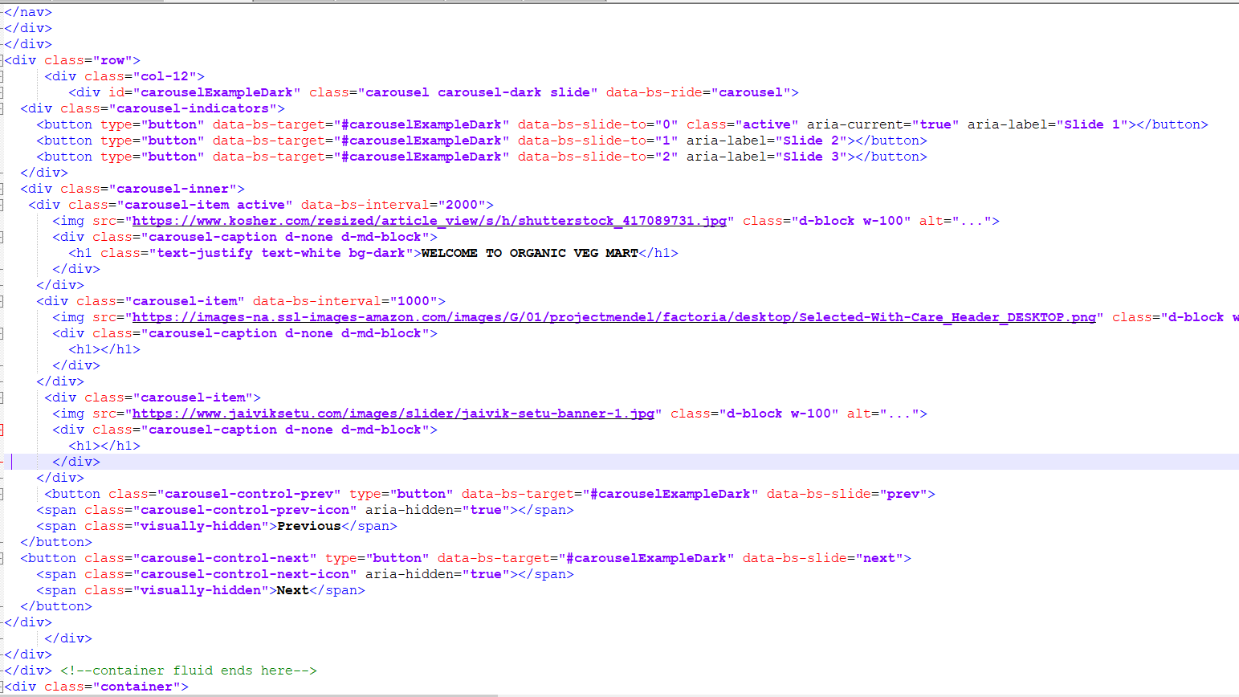
SAMPLE APPLICATION CODE

Slide 11
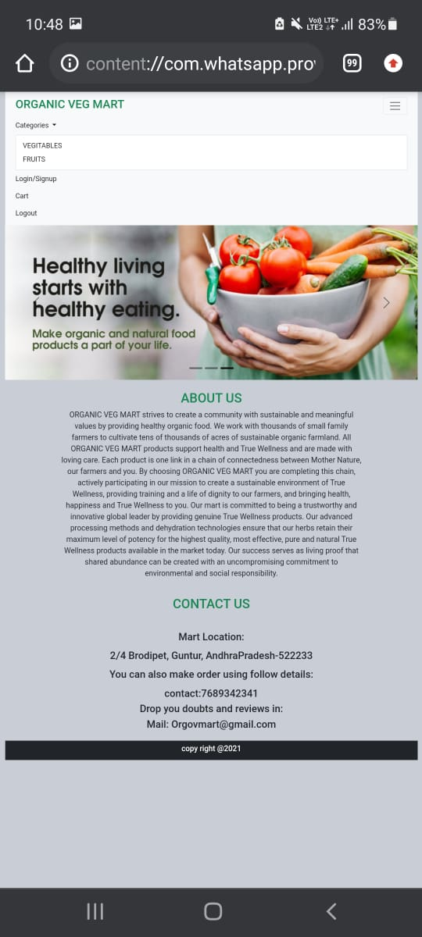
SCREEN SHOTS OF IMPLEMENATATION
INDEX PAGE: MOBILE VIEW
Mobile view of our project represents the responsiveness of the website.

Slide 12
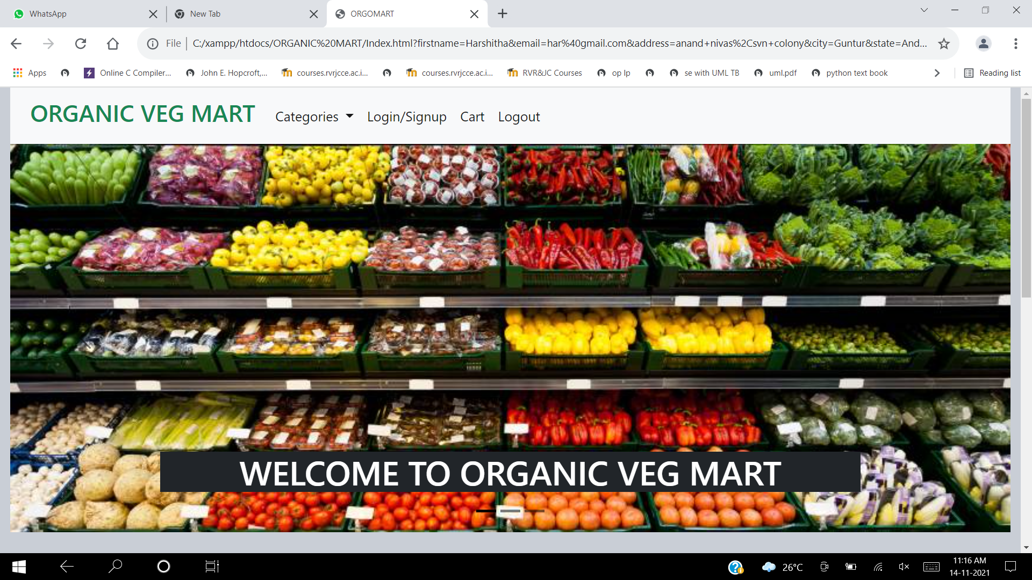
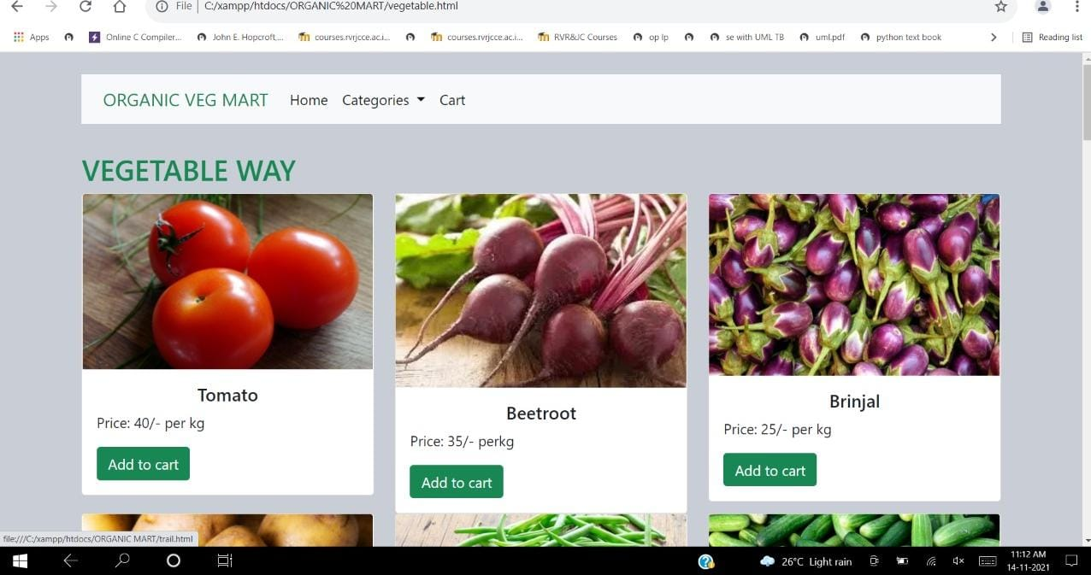
INDEX PAGE: DESKTOP VIEW
CATEGORICAL VIEW:

Slide 13
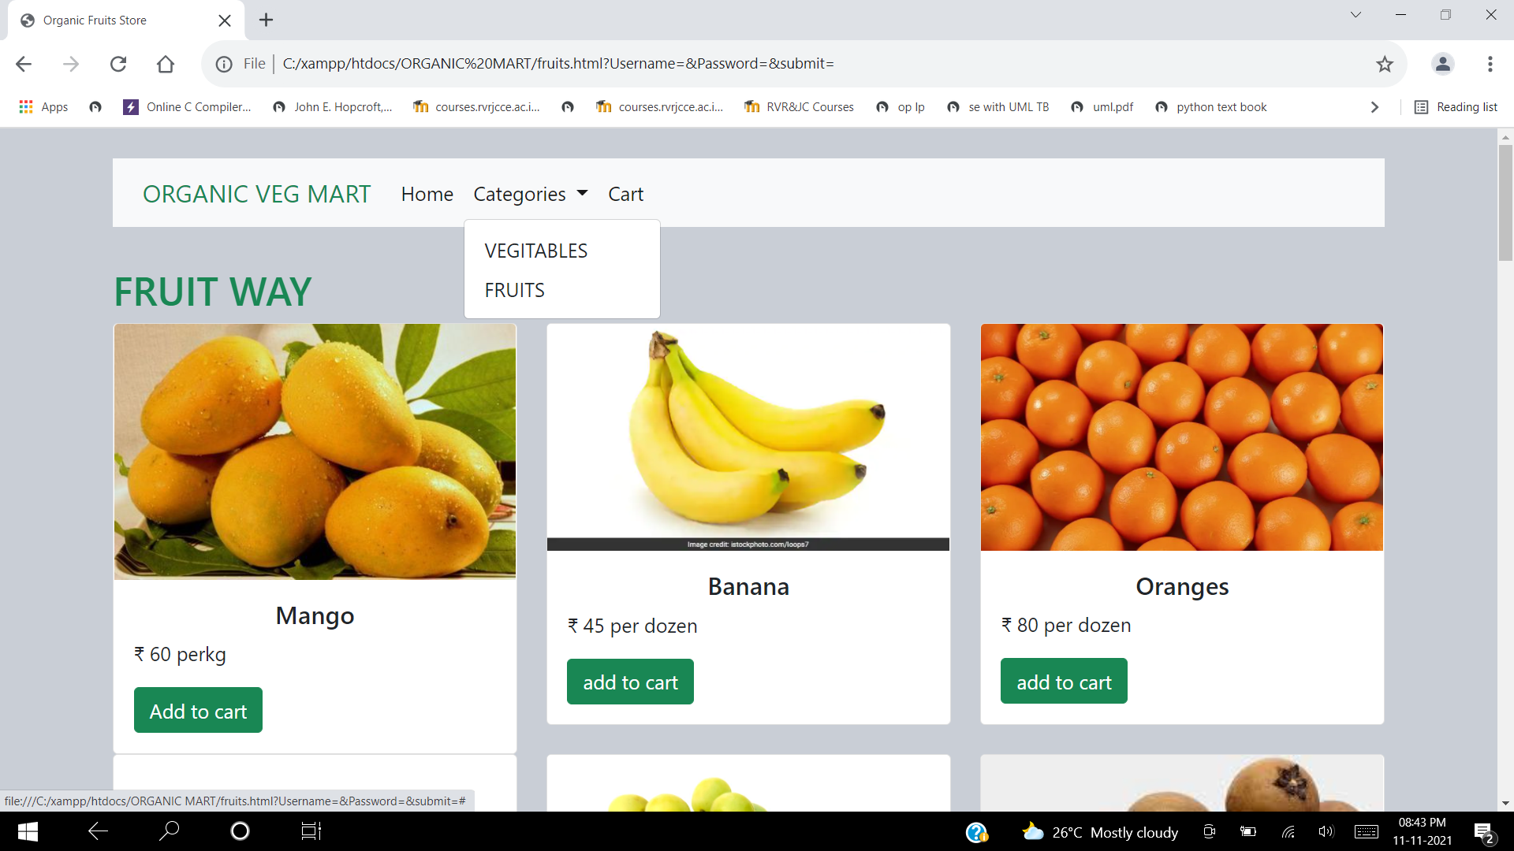
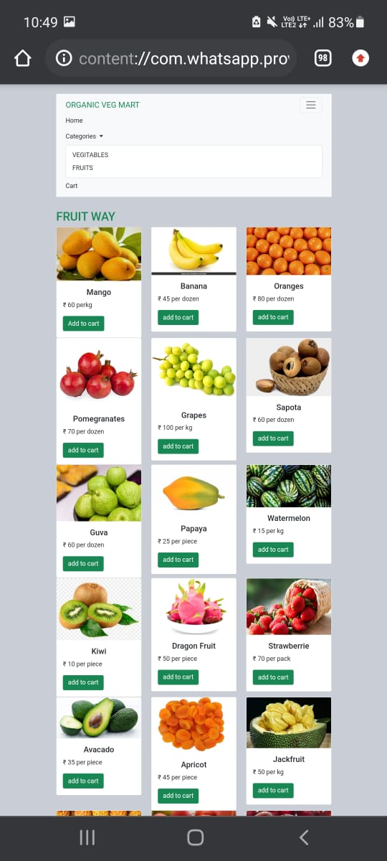
FRUITS VIEW ON DESKTOP
FRUITS VIEW ON MOBILE

Slide 14
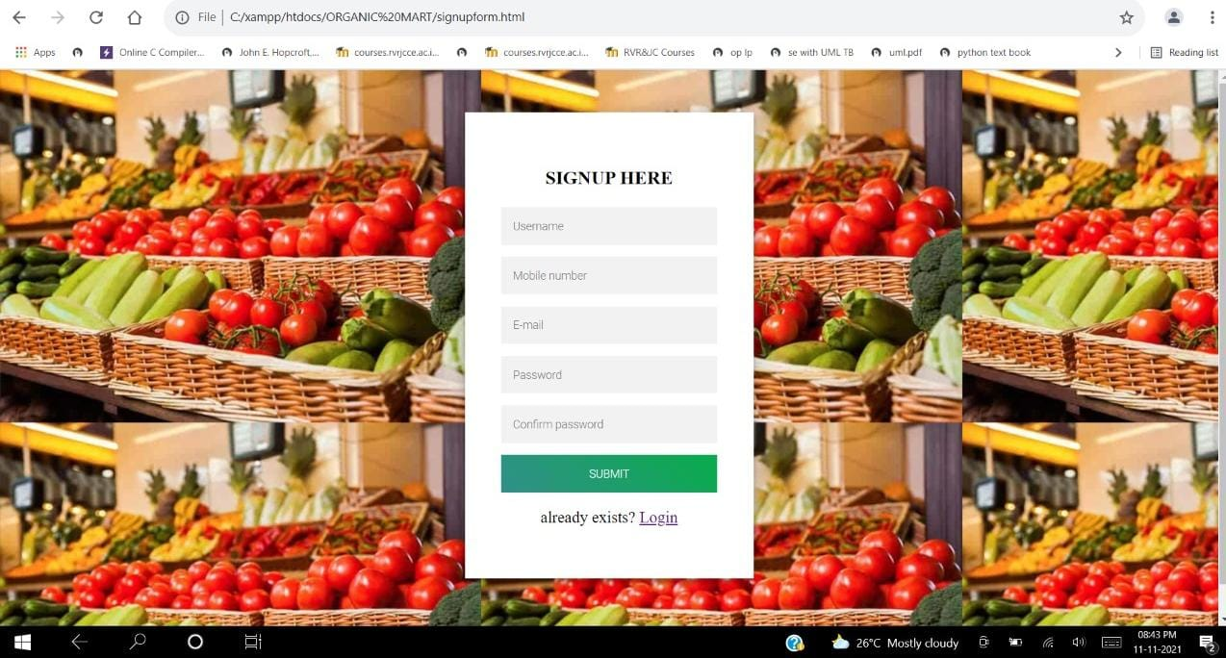
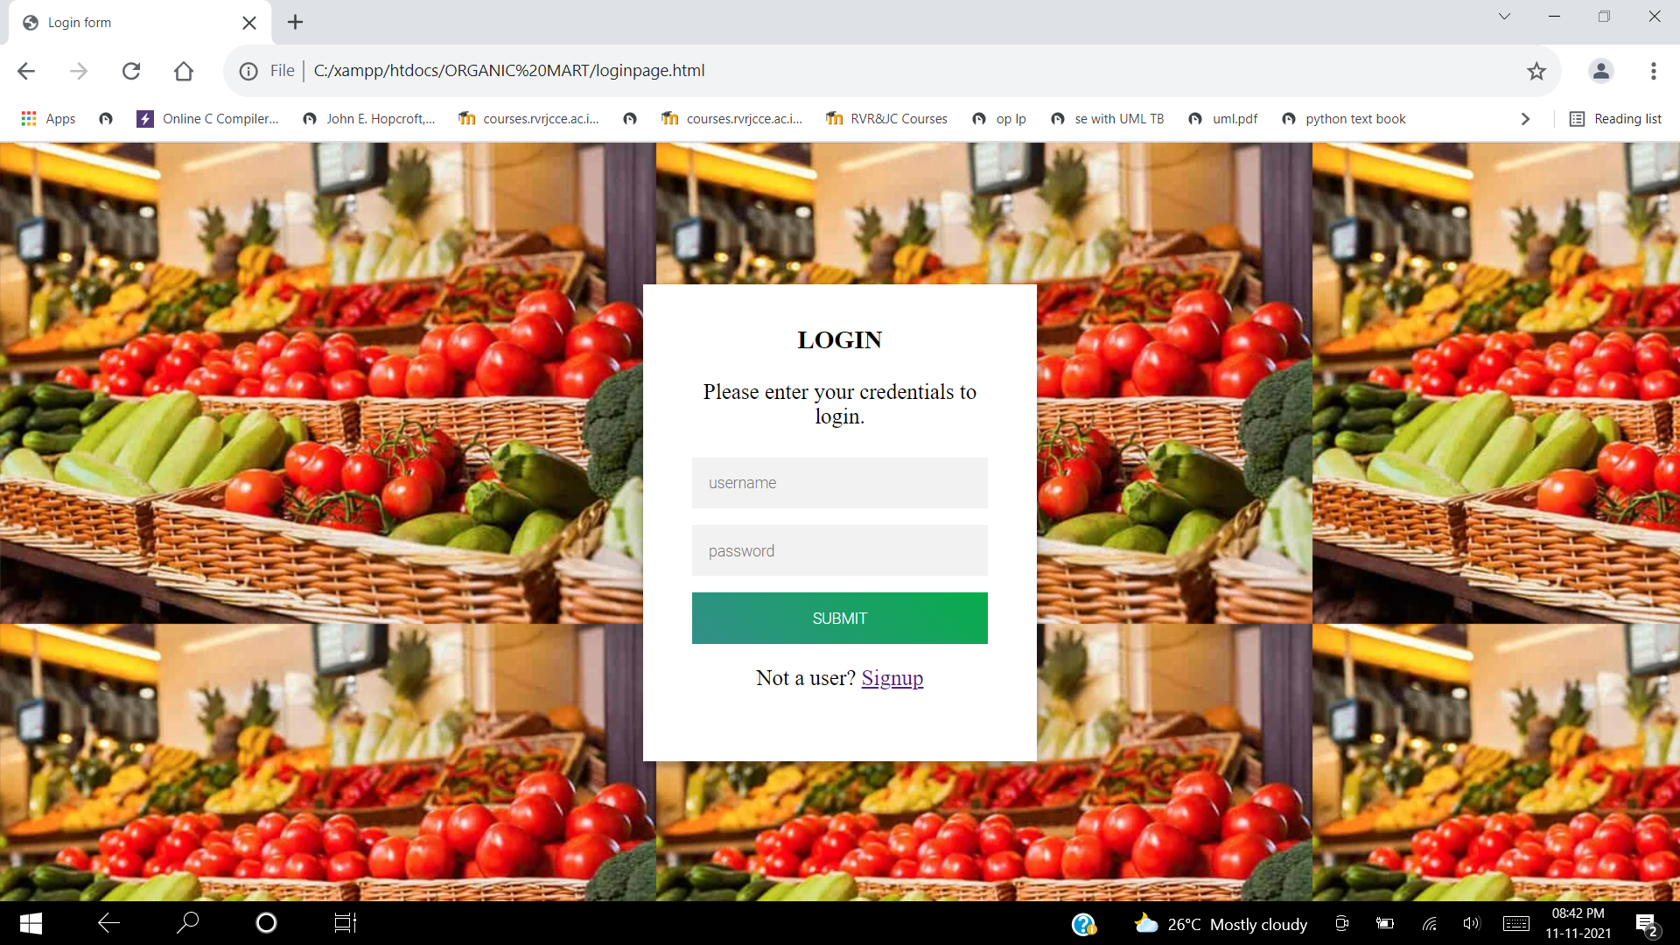
SIGNUP VIEW
LOGIN VIEW

Slide 15
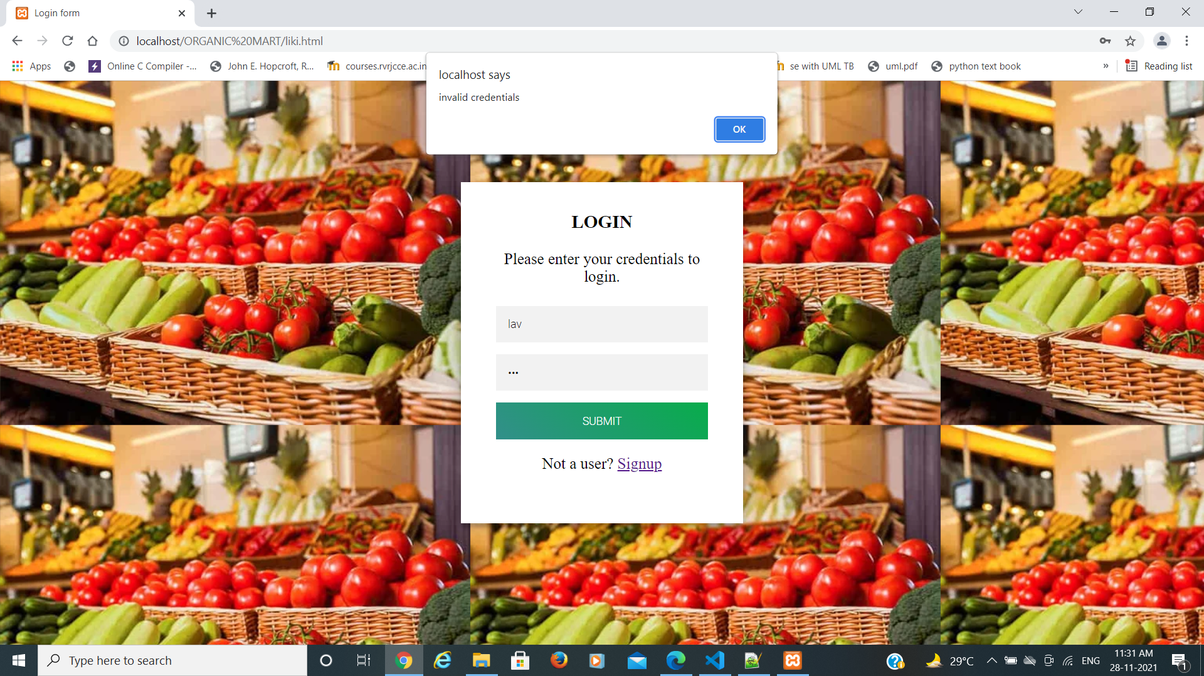
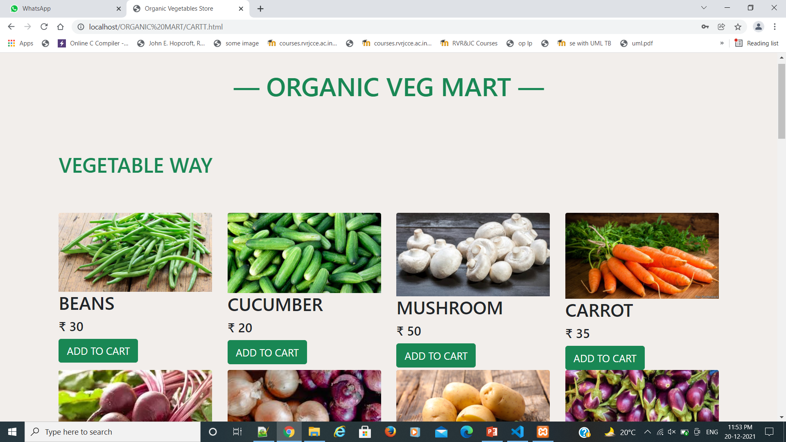
When given credentials are wrong
After successful login

Slide 16
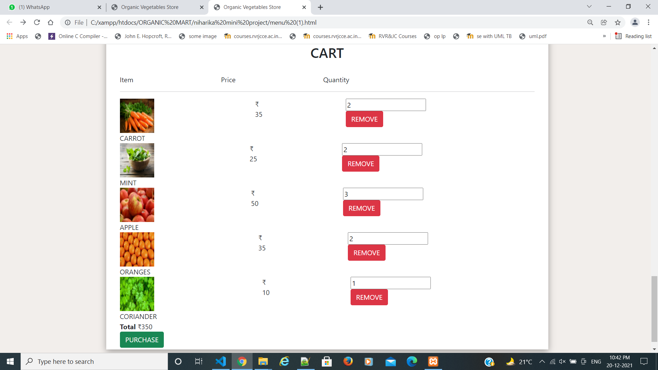
CART

Slide 17
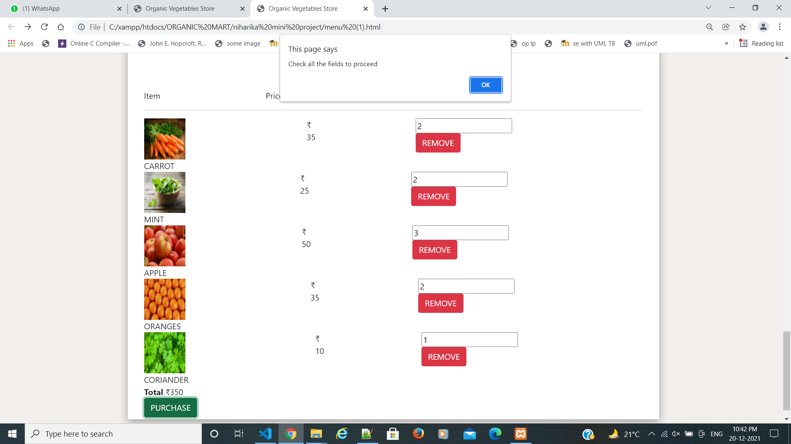
Before
Confirming the
Payment

Slide 18
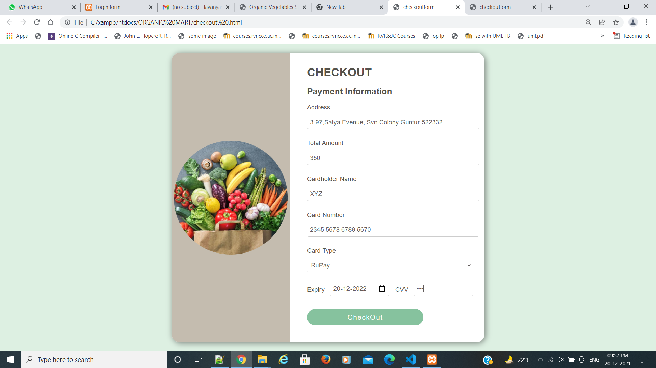
Checkout form

Slide 19
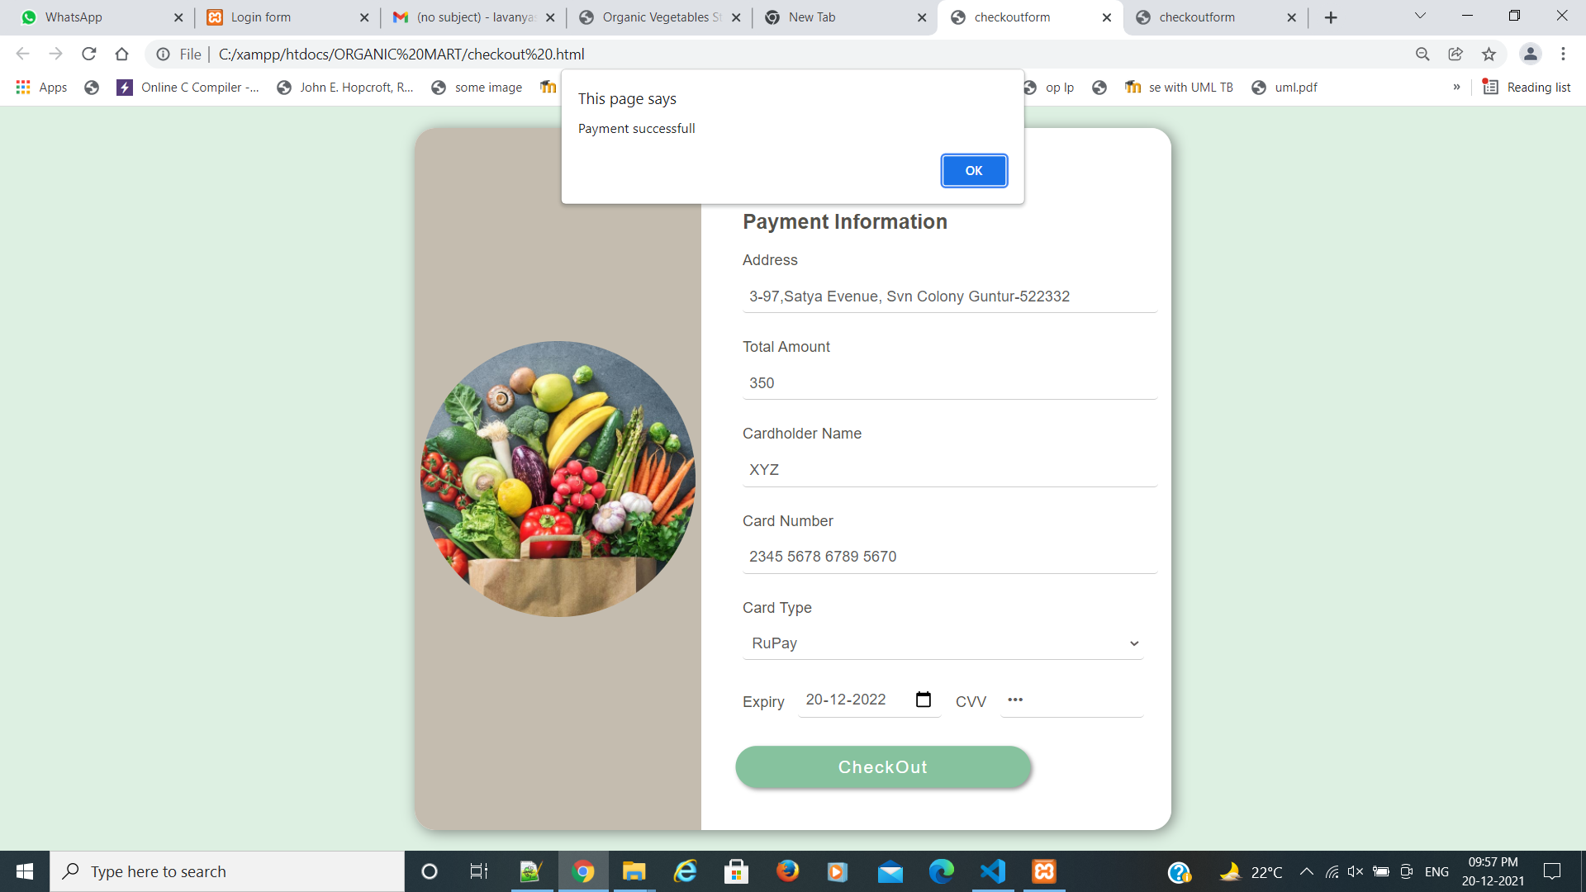
Confirmation popup

Slide 20
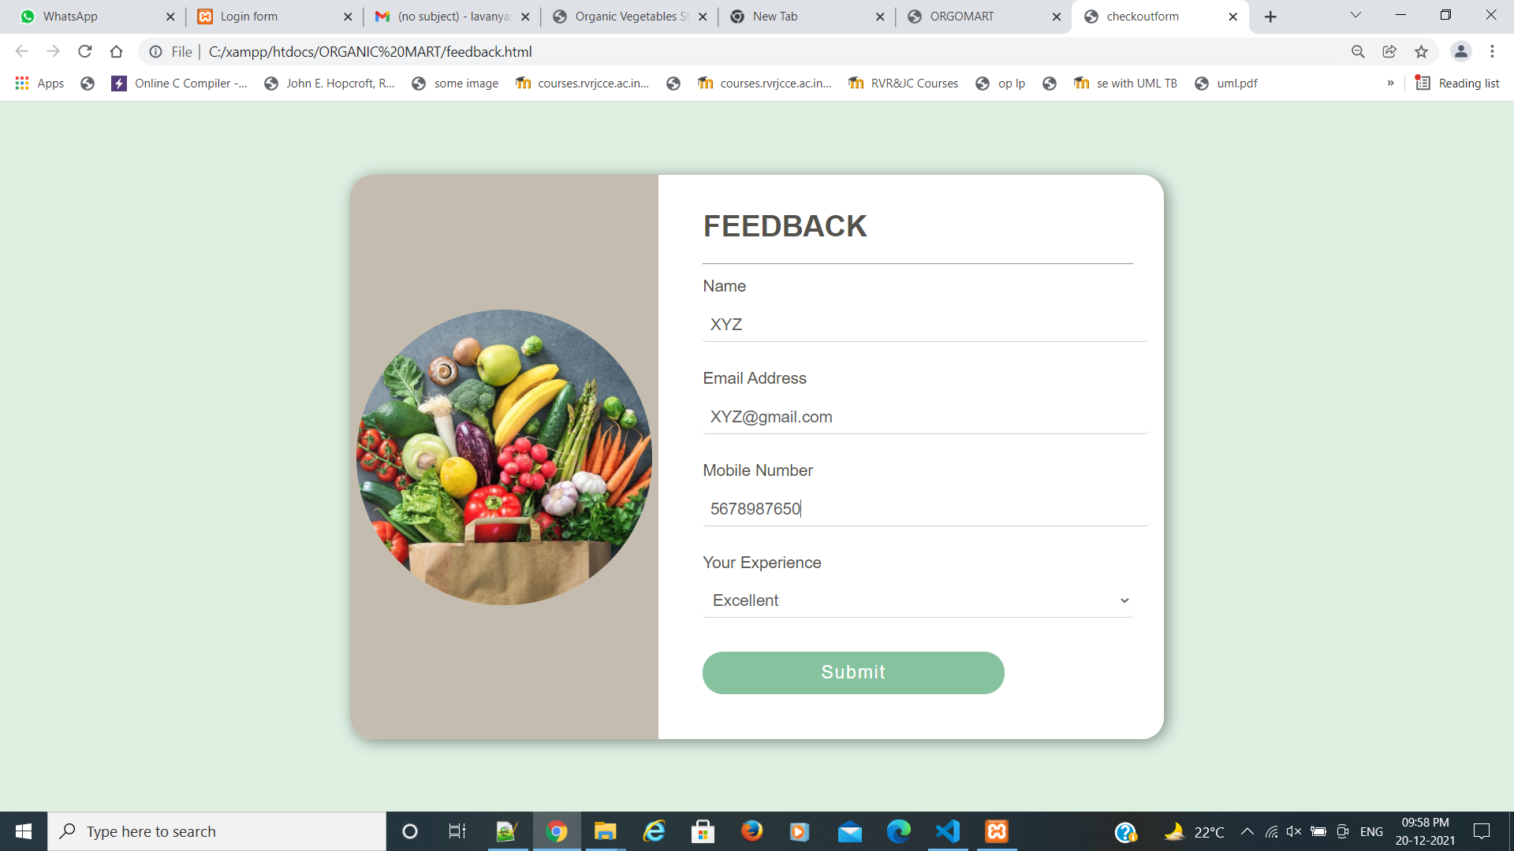
Feedback form

Slide 21
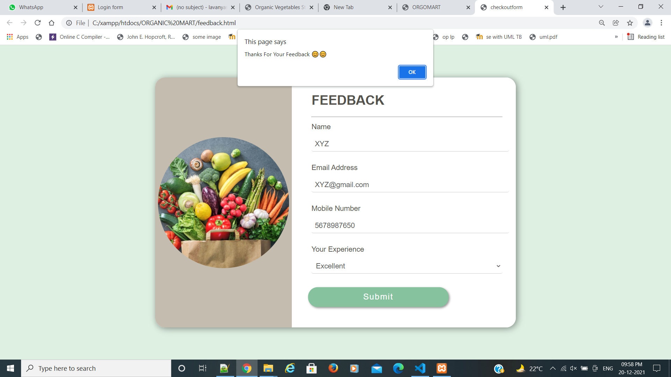
After submitting
Feedback form

Slide 22
CONCLUSION
Online shopping is the best method for shopping our essential needs especially in this pandemic situations but we have to be care full while shopping online. So, only by your essential groceries at certified online stores. Be cautious with fraudulent messages/calls during the payment process.
EAT HEALTHY TO STAY HEALTHY
ORGANIC -VEG- MART

Slide 23
Slide Tite
THANK YOU
DONE BY:
SAMINENI LAVANYA (Y19CB053)
POTTI HARSHITHA (Y19CB048)
SHAIK ABDUL AZEEZ (Y19CB054)

